Slide 1
Introduction
Project History
Existing Systems
Improving the System
Designing the System
Payback Analysis
Depth Summary
Structural Breadth
Construction Breadth
Conclusions
Q & A
senior thesis presentation

Slide 2
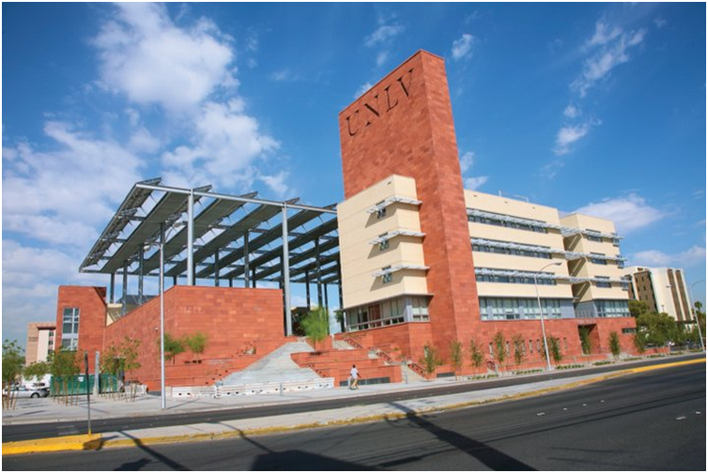
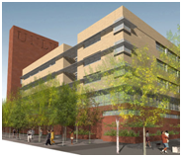
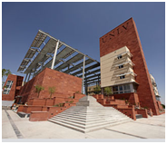
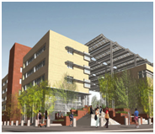
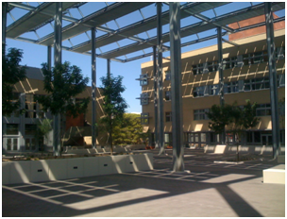
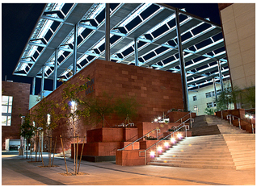
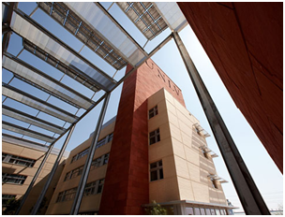
Introduction
Project History
Existing Systems
Improving the System
Designing the System
UNLV Greenspun Hall
Las Vegas, Nevada
Payback Analysis
Depth Summary
Structural Breadth
Construction Breadth
Conclusions
Q & A
introduction
senior thesis presentation

Slide 3
introduction
project history
Introduction
Project History
Existing Systems
Officially dedicated on December 2, 2008
Classrooms and offices
LEED Gold Certification
Two buildings sharing a central courtyard and basement
Design Objectives: Innovation and efficient design
represents a commitment and investment for the future through its sustainable design and architecture
Improving the System
Designing the System
UNLV Greenspun Hall
Las Vegas, Nevada
Payback Analysis
Depth Summary
Structural Breadth
Construction Breadth
Conclusions
Q & A

Slide 4
project history
existing systems
Introduction
Project History
Existing Systems
3 dedicated outdoor air AHU’s, 5 total
Chilled Beam distribution
(2) Carrier 19XR Centrifugal Chillers
(2) Marley Open Cell Cooling Towers
Basic Heat Rejection Loop and Load Loop
Improving the System
Designing the System
Mechanical System
System Description
Payback Analysis
Depth Summary
Structural Breadth
Construction Breadth
Conclusions
Q & A

Slide 5
existing systems
Introduction
Project History
Existing Systems
Structural
Concrete structure
Steel framing supports photovoltaic array
Foundation – spread and strip footers
Roof – Non composite deck on 7’ joist spacing
Electrical
Photovoltaic array – 50,000 KWh’s/year
Lighting – 1.1 watts/ft²
3 distribution panels – total = 2,200 amps
Improving the System
Designing the System
Other Systems
Payback Analysis
Depth Summary
Structural Breadth
Construction Breadth
Conclusions
Q & A

Slide 6
existing systems
improving the system
Introduction
Project History
Existing Systems
3 Alternatives
(1) Replace existing chillers w/ absorption chillers
Solar absorber array to drive generators
(2) Add chilled water storage to Alternative 1
(3) Add chilled water storage to existing system
Improving the System
Designing the System
Payback Analysis
Goal:
make a LEED Gold building better
Depth Summary
Structural Breadth
Construction Breadth
Conclusions
Q & A

Slide 7
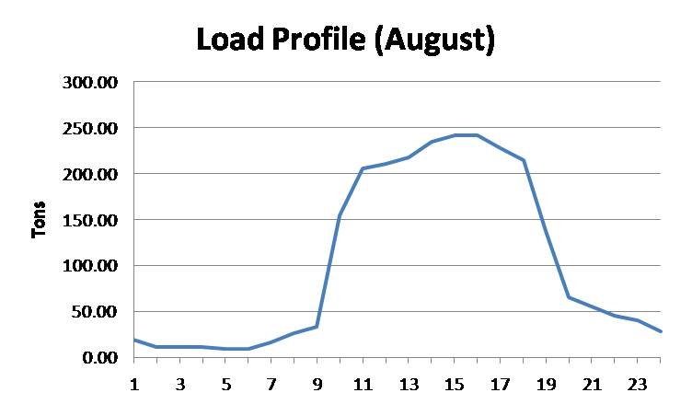
designing the system
improving the system
Introduction
Project History
Existing Systems
Load profiles taken from TRACE 700 calc
Simplify the calculation
Every month has a typical day
Every typical day has a load profile and TMY data
Used to calculate existing system (control) and alternative’s annual regulated energy costs
Improving the System
Designing the System
Payback Analysis
Depth Summary
Procedure
Structural Breadth
Construction Breadth
Conclusions
Q & A

Slide 8
designing the system
Introduction
 | Cooling Load (tons) vs. Hour/day
 | J | F | M | A | M | J | J | A | S | O | N | D
0:01 - 1:00 | 0 | 0 | 0 | 0 | 0 | 17.39 | 17.91 | 19.33 | 15.93 | 0 | 0 | 0
1:01 - 2:00 | 0 | 0 | 0 | 0 | 0 | 10.87 | 11.2 | 12.08 | 9.96 | 0 | 0 | 0
2:01 - 3:00 | 0 | 0 | 0 | 0 | 0 | 10.87 | 11.2 | 12.08 | 9.96 | 0 | 0 | 0
3:01 - 4:00 | 0 | 0 | 0 | 0 | 0 | 10.87 | 11.2 | 12.08 | 9.96 | 0 | 0 | 0
4:01 - 5:00 | 0 | 0 | 0 | 0 | 0 | 8.69 | 8.96 | 9.66 | 7.97 | 0 | 0 | 0
5:01 - 6:00 | 0 | 0 | 0 | 0 | 0 | 8.69 | 8.96 | 9.66 | 7.97 | 0 | 0 | 0
6:01 - 7:00 | 0 | 0 | 0 | 0 | 0 | 15.22 | 15.67 | 16.91 | 13.94 | 0 | 0 | 0
7:01 - 8:00 | 6.62 | 5.99 | 6.37 | 5.62 | 6.39 | 23.91 | 24.63 | 26.57 | 21.91 | 6.7 | 6.18 | 6.29
8:01 - 9:00 | 8.43 | 7.62 | 8.11 | 7.16 | 8.13 | 30.43 | 31.35 | 33.82 | 27.88 | 8.53 | 7.87 | 8.01
9:01 - 10:00 | 38.52 | 34.85 | 37.07 | 32.72 | 37.19 | 139.11 | 143.31 | 154.6 | 127.45 | 38.97 | 35.98 | 36.61
10:01 - 11:00 | 51.16 | 46.28 | 49.23 | 43.46 | 49.39 | 184.76 | 190.33 | 205.33 | 169.27 | 51.76 | 47.79 | 48.62
11:01 - 12:00 | 52.37 | 47.37 | 50.39 | 44.48 | 50.55 | 189.11 | 194.81 | 210.16 | 173.26 | 52.98 | 48.91 | 49.77
12:01 - 13:00 | 54.17 | 49 | 52.13 | 46.02 | 52.3 | 195.63 | 201.53 | 217.41 | 179.23 | 54.8 | 50.6 | 51.48
13:01 - 14:00 | 58.39 | 52.81 | 56.18 | 49.59 | 56.36 | 210.84 | 217.2 | 234.32 | 193.17 | 59.07 | 54.53 | 55.49
14:01 - 15:00 | 60.19 | 54.45 | 57.92 | 51.13 | 58.11 | 217.37 | 223.92 | 241.57 | 199.14 | 60.89 | 56.22 | 57.2
15:01 - 16:00 | 60.19 | 54.45 | 57.92 | 51.13 | 58.11 | 217.37 | 223.92 | 241.57 | 199.14 | 60.89 | 56.22 | 57.2
16:01 - 17:00 | 56.58 | 51.18 | 54.44 | 48.06 | 54.62 | 204.32 | 210.49 | 227.07 | 187.2 | 57.24 | 52.85 | 53.77
17:01 - 18:00 | 53.57 | 48.46 | 51.55 | 45.5 | 51.71 | 193.46 | 199.29 | 214.99 | 177.24 | 54.2 | 50.04 | 50.91
18:01 - 19:00 | 34.31 | 31.03 | 33.01 | 29.14 | 33.12 | 123.9 | 127.64 | 137.69 | 113.51 | 34.71 | 32.05 | 32.61
19:01 - 20:00 | 16.25 | 14.7 | 15.64 | 13.8 | 15.69 | 58.69 | 60.46 | 65.22 | 53.77 | 16.44 | 15.18 | 15.44
20:01 - 21:00 | 13.84 | 12.52 | 13.32 | 11.76 | 13.36 | 49.99 | 51.5 | 55.56 | 45.8 | 14.01 | 12.93 | 13.16
21:01 - 22:00 | 11.44 | 10.34 | 11 | 9.71 | 11.04 | 41.3 | 42.55 | 45.9 | 37.84 | 11.57 | 10.68 | 10.87
22:01 - 23:00 | 10.23 | 9.26 | 9.85 | 8.69 | 9.88 | 36.95 | 38.07 | 41.07 | 33.85 | 10.35 | 9.56 | 9.72
23:01 - 24:00 | 0 | 0 | 0 | 0 | 0 | 26.08 | 26.87 | 28.99 | 23.9 | 0 | 0 | 0
Project History
Existing Systems
Convert Load Profiles to KW’s using chiller η
0.837 KW/ton
Use consumption and demand charges to calculate annual cost ~ $35,000
Improving the System
Designing the System
Payback Analysis
Depth Summary
Control
Structural Breadth
Construction Breadth
Electric Charge |  | Summer | All Other Periods
 | On-Peak | $0.10001 | $0.06406
Consumption | Mid-Peak | $0.0865
 | Off-Peak | $0.06230
 | On-Peak | $9.17 | $0.50
Demand | Mid-Peak | $0.68
 | Off-Peak | $0.00
Conclusions
Q & A

Slide 9
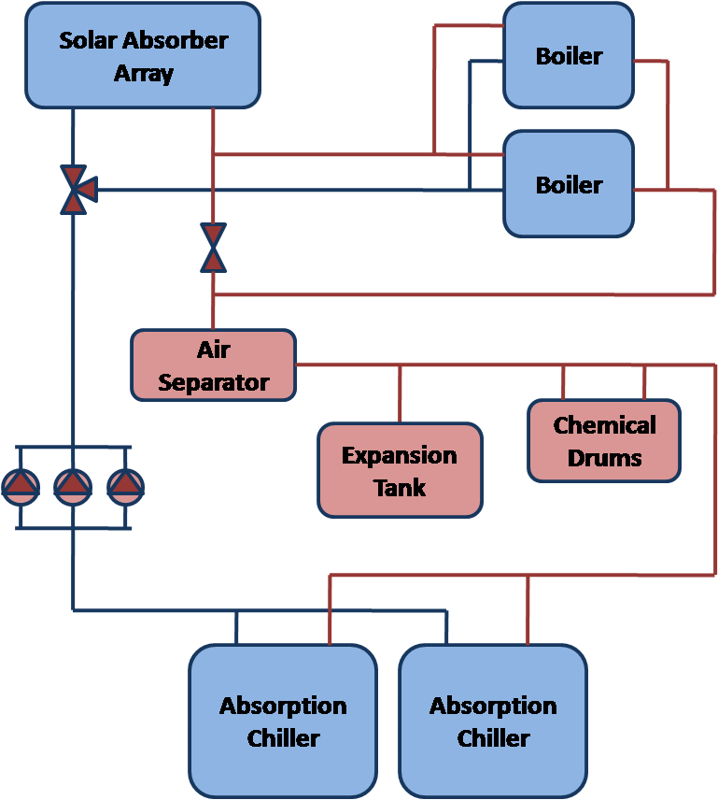
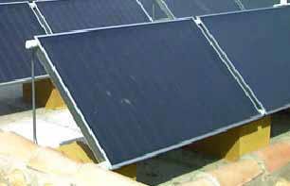
designing the system
Introduction
Project History
Existing Systems
(2) Single Effect Absorption Chillers
Solar absorber array
(2) Back-up Boilers
Improving the System
Designing the System
Payback Analysis
Depth Summary
Alternative 1
Structural Breadth
Construction Breadth
Conclusions
Q & A

Slide 10
designing the system
Introduction
Average Hourly Statistics for Direct Normal Solar Radiation Wh/m²
Hour | J | F | M | A | M | J | J | A | S | O | N | D
0:01 - 1:00 | 0 | 0 | 0 | 0 | 0 | 0 | 0 | 0 | 0 | 0 | 0 | 0
1:01 - 2:00 | 0 | 0 | 0 | 0 | 0 | 0 | 0 | 0 | 0 | 0 | 0 | 0
2:01 - 3:00 | 0 | 0 | 0 | 0 | 0 | 0 | 0 | 0 | 0 | 0 | 0 | 0
3:01 - 4:00 | 0 | 0 | 0 | 0 | 0 | 0 | 0 | 0 | 0 | 0 | 0 | 0
4:01 - 5:00 | 0 | 0 | 0 | 1 | 42 | 69 | 42 | 2 | 0 | 0 | 0 | 0
5:01 - 6:00 | 0 | 0 | 16 | 185 | 340 | 429 | 347 | 253 | 90 | 23 | 0 | 0
6:01 - 7:00 | 0 | 68 | 244 | 501 | 535 | 640 | 605 | 551 | 452 | 381 | 161 | 27
7:01 - 8:00 | 302 | 348 | 457 | 674 | 687 | 736 | 726 | 701 | 644 | 646 | 481 | 371
8:01 - 9:00 | 510 | 523 | 545 | 720 | 777 | 784 | 755 | 780 | 695 | 730 | 607 | 549
9:01 - 10:00 | 588 | 606 | 593 | 770 | 798 | 752 | 797 | 807 | 798 | 767 | 689 | 613
10:01 - 11:00 | 655 | 679 | 588 | 769 | 761 | 791 | 810 | 815 | 833 | 748 | 697 | 687
11:01 - 12:00 | 642 | 630 | 615 | 766 | 679 | 760 | 820 | 812 | 817 | 780 | 735 | 676
12:01 - 13:00 | 598 | 662 | 641 | 714 | 689 | 770 | 802 | 752 | 817 | 756 | 724 | 675
13:01 - 14:00 | 577 | 620 | 578 | 673 | 718 | 759 | 775 | 682 | 752 | 696 | 696 | 658
14:01 - 15:00 | 564 | 543 | 554 | 649 | 690 | 703 | 756 | 658 | 641 | 675 | 629 | 602
15:01 - 16:00 | 476 | 443 | 429 | 607 | 658 | 698 | 686 | 585 | 604 | 596 | 463 | 406
16:01 - 17:00 | 144 | 265 | 314 | 470 | 585 | 606 | 614 | 534 | 441 | 323 | 117 | 44
17:01 - 18:00 | 0 | 15 | 108 | 266 | 352 | 435 | 494 | 369 | 160 | 13 | 0 | 0
18:01 - 19:00 | 0 | 0 | 0 | 17 | 46 | 152 | 182 | 53 | 0 | 0 | 0 | 0
19:01 - 20:00 | 0 | 0 | 0 | 0 | 0 | 0 | 0 | 0 | 0 | 0 | 0 | 0
20:01 - 21:00 | 0 | 0 | 0 | 0 | 0 | 0 | 0 | 0 | 0 | 0 | 0 | 0
21:01 - 22:00 | 0 | 0 | 0 | 0 | 0 | 0 | 0 | 0 | 0 | 0 | 0 | 0
22:01 - 23:00 | 0 | 0 | 0 | 0 | 0 | 0 | 0 | 0 | 0 | 0 | 0 | 0
23:01 - 24:00 | 0 | 0 | 0 | 0 | 0 | 0 | 0 | 0 | 0 | 0 | 0 | 0
Project History
Existing Systems
Solar absorber array can sufficiently maintain the hot water temperature needed to drive the generators
425 absorbers = 17,000 ft²
Boilers only needed when the sun isn’t shining
System consumes natural gas instead of electricity
Improving the System
Designing the System
Payback Analysis
Depth Summary
Alternative 1
Structural Breadth
Construction Breadth
Conclusions
Q & A

Slide 11
designing the system
Introduction
Project History
Gas Firing Rate (CHF) of Boiler vs. Hour/day
Hour | J | F | M | A | M | J | J | A | S | O | N | D
0:01 - 1:00 | 0 | 0 | 0 | 0 | 0 | 376.04 | 387.38 | 417.91 | 344.52 | 0 | 0 | 0
1:01 - 2:00 | 0 | 0 | 0 | 0 | 0 | 235.03 | 242.12 | 261.19 | 215.32 | 0 | 0 | 0
2:01 - 3:00 | 0 | 0 | 0 | 0 | 0 | 235.03 | 242.12 | 261.19 | 215.32 | 0 | 0 | 0
3:01 - 4:00 | 0 | 0 | 0 | 0 | 0 | 235.03 | 242.12 | 261.19 | 215.32 | 0 | 0 | 0
4:01 - 5:00 | 0 | 0 | 0 | 0 | 0 | 188.02 | 193.69 | 208.96 | 172.26 | 0 | 0 | 0
5:01 - 6:00 | 0 | 0 | 0 | 0 | 0 | 188.02 | 193.69 | 208.96 | 172.26 | 0 | 0 | 0
6:01 - 7:00 | 0 | 0 | 0 | 0 | 0 | 0 | 0 | 0 | 250.96 | 0 | 0 | 0
7:01 - 8:00 | 143.18 | 129.51 | 105.93 | 0 | 0 | 0 | 0 | 0 | 0 | 0 | 62.71 | 136.07
8:01 - 9:00 | 21.66 | 0 | 0 | 0 | 0 | 0 | 0 | 0 | 0 | 0 | 0 | 0
9:01 - 10:00 | 0 | 0 | 0 | 0 | 0 | 0 | 0 | 0 | 0 | 0 | 0 | 0
10:01 - 11:00 | 0 | 0 | 0 | 0 | 0 | 0 | 0 | 0 | 0 | 0 | 0 | 0
11:01 - 12:00 | 0 | 0 | 0 | 0 | 0 | 0 | 0 | 0 | 0 | 0 | 0 | 0
12:01 - 13:00 | 0 | 0 | 0 | 0 | 0 | 0 | 0 | 0 | 0 | 0 | 0 | 0
13:01 - 14:00 | 0 | 0 | 0 | 0 | 0 | 0 | 0 | 0 | 0 | 0 | 0 | 0
14:01 - 15:00 | 0 | 0 | 0 | 0 | 0 | 0 | 0 | 0 | 0 | 0 | 0 | 0
15:01 - 16:00 | 690.7 | 1116.28 | 0 | 0 | 0 | 0 | 0 | 0 | 0 | 0 | 842.53 | 1237.01
16:01 - 17:00 | 1223.57 | 1106.75 | 1177.35 | 629.02 | 0 | 0 | 0 | 0 | 3942.67 | 1237.82 | 1142.84 | 1162.79
17:01 - 18:00 | 1158.49 | 1047.88 | 1114.73 | 984.04 | 1118.33 | 4183.47 | 4309.66 | 4649.26 | 3832.77 | 1171.98 | 1082.05 | 1100.94
18:01 - 19:00 | 741.95 | 671.11 | 713.93 | 630.23 | 716.24 | 2679.3 | 2760.12 | 2977.62 | 2454.7 | 750.59 | 693 | 705.1
19:01 - 20:00 | 351.45 | 317.9 | 338.18 | 298.53 | 339.27 | 1269.14 | 1307.42 | 1410.45 | 1162.75 | 355.54 | 328.26 | 333.99
20:01 - 21:00 | 299.38 | 270.8 | 288.08 | 254.3 | 289.01 | 1081.12 | 1113.73 | 1201.49 | 990.49 | 302.87 | 279.63 | 284.51
21:01 - 22:00 | 247.32 | 223.7 | 237.98 | 210.08 | 238.75 | 893.1 | 920.04 | 992.54 | 818.23 | 250.2 | 231 | 235.03
22:01 - 23:00 | 221.28 | 200.16 | 212.93 | 187.96 | 213.61 | 799.09 | 823.19 | 888.06 | 732.1 | 223.86 | 206.68 | 210.29
23:01 - 24:00 | 0 | 0 | 0 | 0 | 0 | 564.06 | 581.08 | 626.87 | 516.78 | 0 | 0 | 0
Existing Systems
Annual Regulated Energy Cost
Improving the System
Designing the System
Chiller Output
Payback Analysis
η_{chiller}
Depth Summary
Alternative 1
Structural Breadth
Generator Input = Boiler Output
Construction Breadth
Conclusions
η_{boiler}
Q & A
Boiler Input

Slide 12
designing the system
Introduction
Project History
Existing Systems
Regulated Energy Cost
Additional Pumping Cost
Total Annual Operating Cost
$11,370
$3,760
$15,130
Improving the System
Natural Gas Cost Analysis
Month | J | F | M | A | M | J | J | A | S | O | N | D
Days | 31 | 28 | 31 | 30 | 31 | 30 | 31 | 31 | 30 | 31 | 30 | 31
Therm/day | 5.1 | 5.08 | 4.19 | 3.19 | 2.92 | 12.9 | 13.3 | 14.37 | 16.04 | 4.29 | 4.87 | 5.41
Therm/month | 158.07 | 142.35 | 130 | 95.8 | 90.4 | 388 | 413 | 445.34 | 481.09 | 133.08 | 146 | 168
Cost/Therm | 0.98 | 0.98 | 0.98 | 0.98 | 0.98 | 0.98 | 0.98 | 0.98 | 0.98 | 0.98 | 0.98 | 0.98
Cost/Month | 155.41 | 139.96 | 128 | 94.2 | 88.9 | 381 | 406 | 437.84 | 472.99 | 130.84 | 144 | 165
Base/Month | 30 | 30 | 30 | 30 | 30 | 30 | 30 | 30 | 30 | 30 | 30 | 30
Total/Month | 185.41 | 169.96 | 158 | 124 | 119 | 411 | 436 | 467.84 | 502.99 | 160.84 | 174 | 195
Total | 3103.24
Existing Pump Cost | 8265.62
Additional Pump Cost | 3760
Total System Cost | $15,128.86
Designing the System
Payback Analysis
Depth Summary
Alternative 1
Structural Breadth
Construction Breadth
Conclusions
Q & A

Slide 13
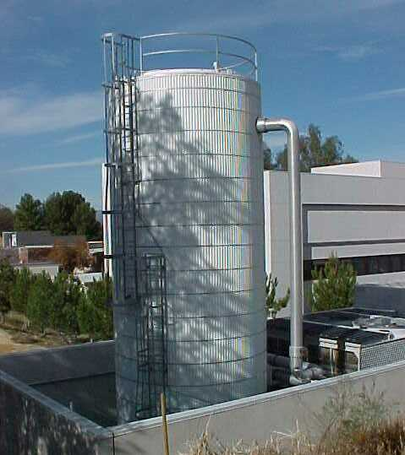
designing the system
Introduction
Project History
Existing Systems
(2) Single Effect Absorption Chillers
Solar absorber array
(2) Back-up Boilers
Chilled Water Storage
Improving the System
Designing the System
Payback Analysis
Depth Summary
Alternative 2
Structural Breadth
Construction Breadth
Conclusions
Q & A

Slide 14
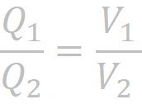
designing the system
Introduction
Project History
Existing Systems
Sizing Strategy: assist absorber array during peak loading to reduce the volume of the array
Not economical to utilize thermal storage for non-peak months
900 ton tank, direct interface
~76,000 gallons
Reduced Solar Array
290 absorbers
Eliminates 135 absorbers and 5,400 ft² of roof space
Improving the System
Designing the System
Payback Analysis
Depth Summary
Alternative 2
Structural Breadth
Construction Breadth
Conclusions
Q & A

Slide 15
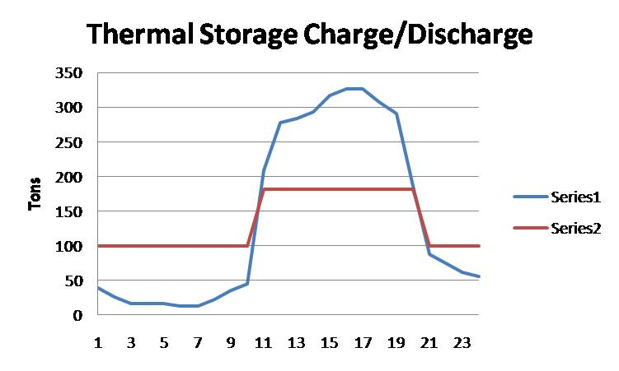
designing the system
Without Storage
With Storage
Introduction
Cooling Load (tons) vs. Hour/day
Hour | J | J | A | S
0:01 - 1:00 | 17.39 | 17.91 | 19.33 | 15.93
1:01 - 2:00 | 10.87 | 11.2 | 12.08 | 9.96
2:01 - 3:00 | 10.87 | 11.2 | 12.08 | 9.96
3:01 - 4:00 | 10.87 | 11.2 | 12.08 | 9.96
4:01 - 5:00 | 8.69 | 8.96 | 9.66 | 7.97
5:01 - 6:00 | 8.69 | 8.96 | 9.66 | 7.97
6:01 - 7:00 | 15.22 | 15.67 | 16.91 | 13.94
7:01 - 8:00 | 23.91 | 24.63 | 26.57 | 21.91
8:01 - 9:00 | 30.43 | 31.35 | 33.82 | 27.88
9:01 - 10:00 | 139.11 | 143.31 | 154.6 | 127.45
10:01 - 11:00 | 184.76 | 190.33 | 205.33 | 169.27
11:01 - 12:00 | 189.11 | 194.81 | 210.16 | 173.26
12:01 - 13:00 | 195.63 | 201.53 | 217.41 | 179.23
13:01 - 14:00 | 210.84 | 217.2 | 234.32 | 193.17
14:01 - 15:00 | 217.37 | 223.92 | 241.57 | 199.14
15:01 - 16:00 | 217.37 | 223.92 | 241.57 | 199.14
16:01 - 17:00 | 204.32 | 210.49 | 227.07 | 187.2
17:01 - 18:00 | 193.46 | 199.29 | 214.99 | 177.24
18:01 - 19:00 | 123.9 | 127.64 | 137.69 | 113.51
19:01 - 20:00 | 58.69 | 60.46 | 65.22 | 53.77
20:01 - 21:00 | 49.99 | 51.5 | 55.56 | 45.8
21:01 - 22:00 | 41.3 | 42.55 | 45.9 | 37.84
22:01 - 23:00 | 36.95 | 38.07 | 41.07 | 33.85
23:01 - 24:00 | 26.08 | 26.87 | 28.99 | 23.9
Cooling Load (tons) vs. Hour/day
Hour | J | J | A | S
0:01 - 1:00 | 100 | 100 | 100 | 100
1:01 - 2:00 | 100 | 100 | 100 | 100
2:01 - 3:00 | 100 | 100 | 100 | 100
3:01 - 4:00 | 100 | 100 | 100 | 100
4:01 - 5:00 | 100 | 100 | 100 | 100
5:01 - 6:00 | 100 | 100 | 100 | 100
6:01 - 7:00 | 100 | 100 | 100 | 100
7:01 - 8:00 | 100 | 100 | 100 | 100
8:01 - 9:00 | 100 | 100 | 100 | 100
9:01 - 10:00 | 39.11 | 43.31 | 54.6 | 27.45
10:01 - 11:00 | 84.76 | 90.33 | 105.33 | 69.27
11:01 - 12:00 | 89.11 | 94.81 | 110.16 | 73.26
12:01 - 13:00 | 95.63 | 101.53 | 117.41 | 79.23
13:01 - 14:00 | 110.84 | 117.2 | 134.32 | 93.17
14:01 - 15:00 | 117.37 | 123.92 | 141.57 | 99.14
15:01 - 16:00 | 117.37 | 123.92 | 141.57 | 99.14
16:01 - 17:00 | 104.32 | 110.49 | 127.07 | 87.2
17:01 - 18:00 | 93.46 | 99.29 | 114.99 | 77.24
18:01 - 19:00 | 123.9 | 127.64 | 137.69 | 113.51
19:01 - 20:00 | 58.69 | 60.46 | 65.22 | 53.77
20:01 - 21:00 | 49.99 | 51.5 | 55.56 | 45.8
21:01 - 22:00 | 41.3 | 42.55 | 45.9 | 37.84
22:01 - 23:00 | 100 | 100 | 100 | 100
23:01 - 24:00 | 100 | 100 | 100 | 100
Project History
Existing Systems
Charging and Discharging
Improving the System
Designing the System
Payback Analysis
Depth Summary
Alternative 2
Structural Breadth
Construction Breadth
Conclusions
Q & A

Slide 16
designing the system
Introduction
Project History
Existing Systems
Regulated Energy Cost
Additional Pumping Cost
Charge/Discharge Tank
Total Annual Operating Cost
$12,825
$1,880
$2,940
$17,645
Improving the System
Natural Gas Cost Analysis
Month | J | F | M | A | M | J | J | A | S | O | N | D
Days | 31 | 28 | 31 | 30 | 31 | 30 | 31 | 31 | 30 | 31 | 30 | 31
Therm/day | 5.1 | 5.08 | 4.19 | 3.19 | 2.92 | 25.24 | 25.55 | 26.37 | 28.03 | 4.29 | 4.87 | 5.41
Therm/month | 158.06 | 142.36 | 129.86 | 95.81 | 90.37 | 757.31 | 792.01 | 817.43 | 841 | 133.08 | 146.06 | 167.57
Cost/Therm | 0.98 | 0.98 | 0.98 | 0.98 | 0.98 | 0.98 | 0.98 | 0.98 | 0.98 | 0.98 | 0.98 | 0.98
Cost/Month | 155.4 | 139.96 | 127.67 | 94.2 | 88.84 | 744.56 | 778.67 | 803.66 | 826.84 | 130.84 | 143.6 | 164.75
Base/Month | 30 | 30 | 30 | 30 | 30 | 30 | 30 | 30 | 30 | 30 | 30 | 30
Total/Month | 185.4 | 169.96 | 157.67 | 124.2 | 118.84 | 774.56 | 808.67 | 833.66 | 856.84 | 160.84 | 173.6 | 194.75
Total | 4559
Existing Pump Cost | 8265.62
Additional Pump Cost | 4820
Total System Cost | $17,644.62
Designing the System
Payback Analysis
Depth Summary
Alternative 2
Structural Breadth
Construction Breadth
Conclusions
Q & A

Slide 17
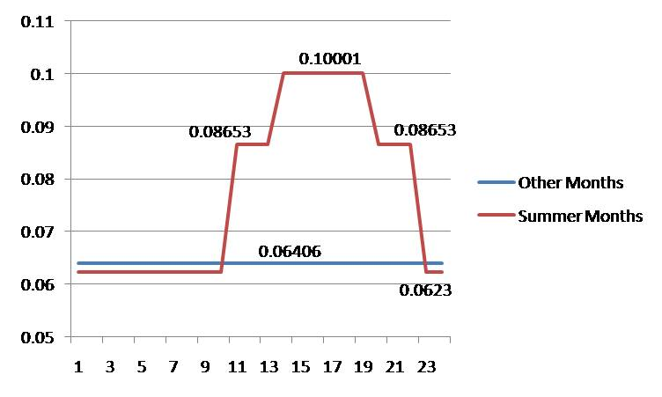
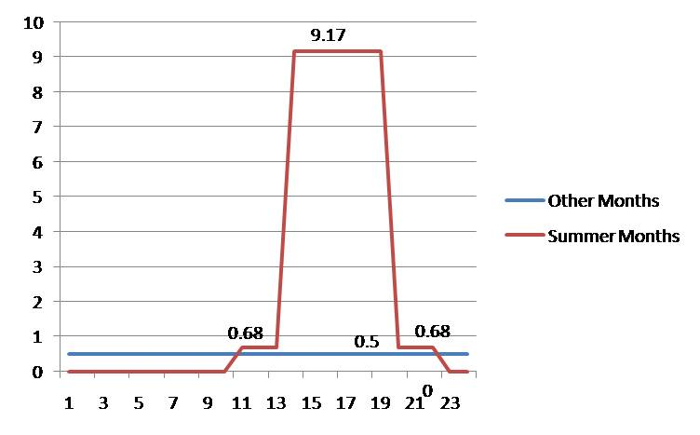
designing the system
Introduction
Project History
Existing Systems
Existing Centrifugal Chillers
Chilled Water Storage
2 sizing strategies
12 hour charge / 12 hour discharge
12 hour charge / 6 hour discharge
Improving the System
Designing the System
Payback Analysis
Depth Summary
Alternative 3
Structural Breadth
Construction Breadth
Conclusions
Q & A

Slide 18
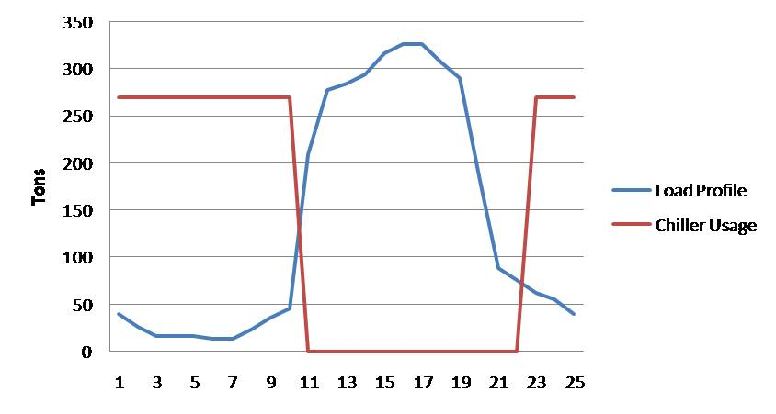
designing the system
Introduction
Project History
Chiller Output (tons) vs. Hour/day
Hour | J | F | M | A | M | J | J | A | S | O | N | D
0:01 - 1:00 | 0 | 0 | 0 | 0 | 0 | 270 | 270 | 270 | 270 | 0 | 0 | 0
1:01 - 2:00 | 0 | 0 | 0 | 0 | 0 | 270 | 270 | 270 | 270 | 0 | 0 | 0
2:01 - 3:00 | 0 | 0 | 0 | 0 | 0 | 270 | 270 | 270 | 270 | 0 | 0 | 0
3:01 - 4:00 | 0 | 0 | 0 | 0 | 0 | 270 | 270 | 270 | 270 | 0 | 0 | 0
4:01 - 5:00 | 0 | 0 | 0 | 0 | 0 | 270 | 270 | 270 | 270 | 0 | 0 | 0
5:01 - 6:00 | 0 | 0 | 0 | 0 | 0 | 270 | 270 | 270 | 270 | 0 | 0 | 0
6:01 - 7:00 | 0 | 0 | 0 | 0 | 0 | 270 | 270 | 270 | 270 | 0 | 0 | 0
7:01 - 8:00 | 6.6 | 6 | 6.4 | 5.6 | 6.4 | 270 | 270 | 270 | 270 | 6.7 | 6.2 | 6.3
8:01 - 9:00 | 8.4 | 7.6 | 8.1 | 7.2 | 8.1 | 270 | 270 | 270 | 270 | 8.5 | 7.9 | 8
9:01 - 10:00 | 39 | 35 | 37 | 33 | 37 | 0 | 0 | 0 | 0 | 39 | 36 | 37
10:01 - 11:00 | 51 | 46 | 49 | 43 | 49 | 0 | 0 | 0 | 0 | 52 | 48 | 49
11:01 - 12:00 | 52 | 47 | 50 | 44 | 51 | 0 | 0 | 0 | 0 | 53 | 49 | 50
12:01 - 13:00 | 54 | 49 | 52 | 46 | 52 | 0 | 0 | 0 | 0 | 55 | 51 | 51
13:01 - 14:00 | 58 | 53 | 56 | 50 | 56 | 0 | 0 | 0 | 0 | 59 | 55 | 55
14:01 - 15:00 | 60 | 54 | 58 | 51 | 58 | 0 | 0 | 0 | 0 | 61 | 56 | 57
15:01 - 16:00 | 60 | 54 | 58 | 51 | 58 | 0 | 0 | 0 | 0 | 61 | 56 | 57
16:01 - 17:00 | 57 | 51 | 54 | 48 | 55 | 0 | 0 | 0 | 0 | 57 | 53 | 54
17:01 - 18:00 | 54 | 48 | 52 | 46 | 52 | 0 | 0 | 0 | 0 | 54 | 50 | 51
18:01 - 19:00 | 34 | 31 | 33 | 29 | 33 | 0 | 0 | 0 | 0 | 35 | 32 | 33
19:01 - 20:00 | 16 | 15 | 16 | 14 | 16 | 0 | 0 | 0 | 0 | 16 | 15 | 15
20:01 - 21:00 | 14 | 13 | 13 | 12 | 13 | 0 | 0 | 0 | 0 | 14 | 13 | 13
21:01 - 22:00 | 11 | 10 | 11 | 9.7 | 11 | 270 | 270 | 270 | 270 | 12 | 11 | 11
22:01 - 23:00 | 10 | 9.3 | 9.9 | 8.7 | 9.9 | 270 | 270 | 270 | 270 | 10 | 9.6 | 9.7
23:01 - 24:00 | 0 | 0 | 0 | 0 | 0 | 270 | 270 | 270 | 270 | 0 | 0 | 0
Existing Systems
12 hour charge, 12 hour discharge
2,900 ton tank, direct interface
~246,000 gallons
Improving the System
Designing the System
Payback Analysis
Depth Summary
Alternative 3
Structural Breadth
Construction Breadth
Conclusions
Q & A

Slide 19
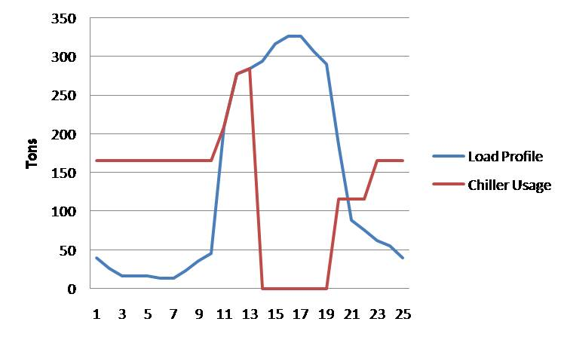
designing the system
Introduction
Project History
Chiller Output (tons) vs. Hour/day
Hour | J | F | M | A | M | J | J | A | S | O | N | D
0:01 - 1:00 | 0 | 0 | 0 | 0 | 0 | 165 | 165 | 165 | 165 | 0 | 0 | 0
1:01 - 2:00 | 0 | 0 | 0 | 0 | 0 | 165 | 165 | 165 | 165 | 0 | 0 | 0
2:01 - 3:00 | 0 | 0 | 0 | 0 | 0 | 165 | 165 | 165 | 165 | 0 | 0 | 0
3:01 - 4:00 | 0 | 0 | 0 | 0 | 0 | 165 | 165 | 165 | 165 | 0 | 0 | 0
4:01 - 5:00 | 0 | 0 | 0 | 0 | 0 | 165 | 165 | 165 | 165 | 0 | 0 | 0
5:01 - 6:00 | 0 | 0 | 0 | 0 | 0 | 165 | 165 | 165 | 165 | 0 | 0 | 0
6:01 - 7:00 | 0 | 0 | 0 | 0 | 0 | 165 | 165 | 165 | 165 | 0 | 0 | 0
7:01 - 8:00 | 6.62 | 5.99 | 6.37 | 5.62 | 6.39 | 165 | 165 | 165 | 165 | 6.7 | 6.18 | 6.29
8:01 - 9:00 | 8.43 | 7.62 | 8.11 | 7.16 | 8.13 | 165 | 165 | 165 | 165 | 8.53 | 7.87 | 8.01
9:01 - 10:00 | 38.52 | 34.85 | 37.07 | 32.72 | 37.19 | 139.11 | 143.31 | 154.6 | 127.45 | 38.97 | 35.98 | 36.61
10:01 - 11:00 | 51.16 | 46.28 | 49.23 | 43.46 | 49.39 | 184.76 | 190.33 | 205.33 | 169.27 | 51.76 | 47.79 | 48.62
11:01 - 12:00 | 52.37 | 47.37 | 50.39 | 44.48 | 50.55 | 189.11 | 194.81 | 210.16 | 173.26 | 52.98 | 48.91 | 49.77
12:01 - 13:00 | 54.17 | 49 | 52.13 | 46.02 | 52.3 | 0 | 0 | 0 | 0 | 54.8 | 50.6 | 51.48
13:01 - 14:00 | 58.39 | 52.81 | 56.18 | 49.59 | 56.36 | 0 | 0 | 0 | 0 | 59.07 | 54.53 | 55.49
14:01 - 15:00 | 60.19 | 54.45 | 57.92 | 51.13 | 58.11 | 0 | 0 | 0 | 0 | 60.89 | 56.22 | 57.2
15:01 - 16:00 | 60.19 | 54.45 | 57.92 | 51.13 | 58.11 | 0 | 0 | 0 | 0 | 60.89 | 56.22 | 57.2
16:01 - 17:00 | 56.58 | 51.18 | 54.44 | 48.06 | 54.62 | 0 | 0 | 0 | 0 | 57.24 | 52.85 | 53.77
17:01 - 18:00 | 53.57 | 48.46 | 51.55 | 45.5 | 51.71 | 0 | 0 | 0 | 0 | 54.2 | 50.04 | 50.91
18:01 - 19:00 | 34.31 | 31.03 | 33.01 | 29.14 | 33.12 | 123.9 | 127.64 | 137.69 | 113.51 | 34.71 | 32.05 | 32.61
19:01 - 20:00 | 16.25 | 14.7 | 15.64 | 13.8 | 15.69 | 58.69 | 60.46 | 65.22 | 53.77 | 16.44 | 15.18 | 15.44
20:01 - 21:00 | 13.84 | 12.52 | 13.32 | 11.76 | 13.36 | 49.99 | 51.5 | 55.56 | 45.8 | 14.01 | 12.93 | 13.16
21:01 - 22:00 | 11.44 | 10.34 | 11 | 9.71 | 11.04 | 165 | 165 | 165 | 165 | 11.57 | 10.68 | 10.87
22:01 - 23:00 | 10.23 | 9.26 | 9.85 | 8.69 | 9.88 | 165 | 165 | 165 | 165 | 10.35 | 9.56 | 9.72
23:01 - 24:00 | 0 | 0 | 0 | 0 | 0 | 165 | 165 | 165 | 165 | 0 | 0 | 0
Existing Systems
12 hour charge, 6 hour discharge
1,800 ton tank, direct interface
~153,000 gallons
Improving the System
Designing the System
Payback Analysis
Depth Summary
Alternative 3
Structural Breadth
Construction Breadth
Conclusions
Q & A

Slide 20
designing the system
Introduction
Project History
246,000 gal Cost Analysis
Month | J | F | M | A | M | J | J | A | S | O | N | D
Max Demand | 50.38 | 45.57 | 48.48 | 42.79 | 48.64 | 225.99 | 225.99 | 225.99 | 225.99 | 50.97 | 47.06 | 47.88
Demand Charge | 0.5 | 0.5 | 0.5 | 0.5 | 0.5 | 9.17 | 9.17 | 9.17 | 9.17 | 0.5 | 0.5 | 0.5
$/month | 25.19 | 22.79 | 24.24 | 21.4 | 24.32 | 2072.33 | 2072.33 | 2072.33 | 2072.33 | 25.48 | 23.53 | 23.94
$/day | 31.44 | 28.43 | 30.25 | 26.7 | 30.35 | 174.43 | 174.43 | 174.43 | 174.43 | 31.8 | 29.36 | 29.87
days | 31 | 28 | 31 | 30 | 31 | 30 | 31 | 31 | 30 | 31 | 30 | 31
Consumption Cost | 974.49 | 796.2 | 937.7 | 801.1 | 940.7 | 5232.78 | 5407.2 | 5407.2 | 5232.78 | 985.8 | 880.8 | 926.1
Total Cost | 37003.2
Existing Systems
12-hour discharge
Regulated Energy Cost
6-hour discharge
Regulated Energy Cost
$37,000
$33,000
Improving the System
Designing the System
Payback Analysis
Depth Summary
Alternative 3
Structural Breadth
153,000 gal Cost Analysis
Month | J | F | M | A | M | J | J | A | S | O | N | D
Max Demand | 50.38 | 45.57 | 48.48 | 42.79 | 48.64 | 158.28 | 163.06 | 175.91 | 145.01 | 50.97 | 47.06 | 47.88
Demand Charge | 0.5 | 0.5 | 0.5 | 0.5 | 0.5 | 9.17 | 9.17 | 9.17 | 9.17 | 0.5 | 0.5 | 0.5
$/month | 25.19 | 22.79 | 24.24 | 21.4 | 24.32 | 1451.46 | 1495.24 | 1613.06 | 1329.78 | 25.48 | 23.53 | 23.94
$/day | 31.44 | 28.43 | 30.25 | 26.7 | 30.35 | 159.17 | 160.75 | 165.02 | 154.76 | 31.8 | 29.36 | 29.87
days | 31 | 28 | 31 | 30 | 31 | 30 | 31 | 31 | 30 | 31 | 30 | 31
Consumption Cost | 974.49 | 796.2 | 937.7 | 801.1 | 940.7 | 4775.04 | 4983.37 | 5115.68 | 4642.82 | 985.8 | 880.8 | 926.1
Total Cost | 32,840.19
Construction Breadth
Conclusions
Q & A

Slide 21
payback analysis
designing the system
Introduction
Project History
Component |  |  | First Cost | Additional First Cost | Annual Maintanence
Control | Chiller | Carrier 19XR | 63,000 | - | 4,000
 | Chiller | Carrier 19XR | 63,000 |  | 4,000
Alternative 1 | Absorption Chiller | Carrier 16LJ | 103,000 | 346,625 | 6,000
 | Absorption Chiller | Carrier 16LJ | 103,000 |  | 6,000
 | Boiler | RBI Futera XLF | 52,000 |  | 500
 | Boiler | RBI Futera XLF | 52,000 |  | 500
 | Solar Absorbers (425) |  | 225,625 |  | 1,000
 | Additional Pumps | B&G | 4,000 |  | --
Alternative 2 | Absorption Chiller | Carrier 16LJ | 103,000 | 430,050 | 6,000
 | Absorption Chiller | Carrier 16LJ | 103,000 |  | 6,000
 | Boiler | RBI Futera XLF | 52,000 |  | 500
 | Boiler | RBI Futera XLF | 52,000 |  | 500
 | Solar Absorbers (290) |  | 187,050 |  | 1,000
 | 900 ton Storage Tank |  | 82,000 |  | --
 | Additional Pumps | B&G | 7,000 |  | --
Alternative 3a | Chiller | Carrier 19XR | 63,000 | 301,000 | 4,000
 | Chiller | Carrier 19XR | 63,000 |  | 4,000
 | 2,900 ton Storage Tank |  | 295,000 |  | --
 | Additional Pumps | B&G | 6,000 |  | --
Alternative 3b | Chiller | Carrier 19XR | 63,000 | 246,000 | 4,000
 | Chiller | Carrier 19XR | 63,000 |  | 4,000
 | 1,650 ton Storage Tank |  | 240,000 |  | --
 | Additional Pumps | B&G | 6,000 |  | --
Simple Payback
Existing Systems
What if?
Hoover dam dries up
Coal must be used to generate electricity
CO² credits could reduce payback periods
Improving the System
Designing the System
Payback Analysis
Depth Summary
Payback Period
CO² Emissions
Simple Payback Calculation
 | Alternative 1 | Alternative 2
Additional First Cost | 346,625 | 430,050
Additional Maintenance Cost | 6,000 | 6,000
Annual Savings | 19,700 | 17,185
Payback Period | 17.60 | 25.02
Structural Breadth
Construction Breadth
Conclusions
Q & A
Alternative 1: 870,000 pounds less
Alternative 2: 655,000 pounds less

Slide 22
depth summary
payback analysis
Introduction
Project History
The existing system achieved its design objectives and achieved LEED Gold
Alternative 1 - 17,000 ft2 of absorbers
Alternative 2 – 11,600 ft2 of absorbers
chilled water storage
Alternative 3 – chilled water storage
Existing Systems
The existing system achieved its design objectives and achieved LEED Gold
Alternative 1 - $15,130, 17.6 year payback
Alternative 2 – $17,645, 25 year payback
Alternative 3 – No annual savings
Innovative and Energy Efficiency
Improving the System
Designing the System
Payback Analysis
Depth Summary
Structural Breadth
Construction Breadth
Conclusions
Q & A

Slide 23
structural breadth
depth summary
Introduction
Project History
Existing Systems
Existing Roof Structure
Non-composite (2C 22)
5” depth
7 ft. spans
98 psf (Vulcraft)
7’1” max clearspan
Solar absorbers: 12.5 psf
Reduce Joist Spacing
6’6”: 113 psf
Use 2C 22 at 6’ spacing
Increase Deck Strength
2C 20
127 psf
8’6” max clearspan
Improving the System
Roof System
Designing the System
Roof Loads
Description | Weight (psf)
Mech./Elec./Plumbing | 10
Roof Mat | 20
Slab/Deck (2C22) | 50
Miscellaneous | 5
Beams/Joists | 10
Total | 95
Payback Analysis
Depth Summary
Structural Breadth
Construction Breadth
Conclusions
Q & A

Slide 24
construction breadth
structural breadth
Introduction
Project History
Cost Analysis
 | Component |  | Material | Labor | Equipment | Total
20 ft. Extension | Strip Footer | 12" x 12" | 259.26 | 26.31 | 0.86 | 286.43
 | Slab | 6" | 1111.11 | 159.44 | 5.00 | 1275.56
 | Wire Fabric | 6x6 | 195.00 | 147.00 | 0.00 | 342.00
 | CMU Wall | 12" x 10ft. | 2169.60 | 3360.00 | 0.00 | 5529.60
 | Formwork |  | 22.40 | 135.10 | 0.00 | 157.50
 | Total Cost |  |  |  |  | 7591.09
30 ft. Extension | Strip Footer | 12" x 12" | 333.33 | 33.83 | 1.10 | 368.27
 | Slab | 6" | 1666.67 | 239.17 | 7.50 | 1913.33
 | Wire Fabric | 6x6 | 292.50 | 220.50 | 0.00 | 513.00
 | CMU Wall | 12" x 10ft. | 3254.40 | 5040.00 | 0.00 | 8294.40
 | Formwork |  | 28.80 | 173.70 | 0.00 | 202.50
 | Total Cost |  |  |  |  | 11291.50
Existing Systems
Thermal Storage Tanks
Calculation shows an extra 20-30 ft. needed
Improving the System
Mechanical Yard
Designing the System
Payback Analysis
Depth Summary
Cooling Tower
Cooling Tower
Structural Breadth
Cooling Tower
Cooling Tower
Construction Breadth
Other Equipment
 | Days of Work
 | 20 ft. Extension | 30 ft. Extension
Strip Footer | 0.05 | 0.06
Formwork | 0.13 | 0.15
Wire Fabric | 0.21 | 0.31
Slab | 0.19 | 0.28
Subtotal | 1 | 1
CMU Wall | 2.4 | 3.6
Total | 3.5 | 5
Conclusions
Q & A
Other Equipment
Thermal Storage Tank

Slide 25
conclusions
construction breadth
Introduction
Project History
Control
Alternative 1
Alternative 2
Existing Systems
lowest initial cost
most energy savings
heaviest roof load
$19,700 cost savings
longer payback
larger mechanical yard
Improving the System
Do, or not to do?
Innovation and Energy Efficiency
Designing the System
Payback Analysis
Depth Summary
“Alternative 1 would not only achieve these goals, but exceed them.”
Structural Breadth
Construction Breadth
Conclusions
Q & A

Slide 26
questions? and maybe some answers
conclusions
Introduction
Project History
Acknowledgements
Advisors: Dr. James Freihaut
Dr. William Bahnfleth
Sponsors: Vanderweil Engineers
State of Nevada Public Works
PSU Students: Thomas Chirdon
Scott Earley
Dominic Manno
Special Thanks to: Bruce Nipp
Fred Livingston, Steve Germano,
and the rest of the
Vanderweil Las Vegas office
Existing Systems
Improving the System
Designing the System
Payback Analysis
Depth Summary
Structural Breadth
Construction Breadth
Conclusions
Q & A

